Slide 1
Optiver – 07
Meeting minutes &
Action point slides
Date: 02/05/2025 (Week 9)
Present: Ayush Singh, Kylie Haryono, Zichun Han, Tobit Louis.

Slide 2
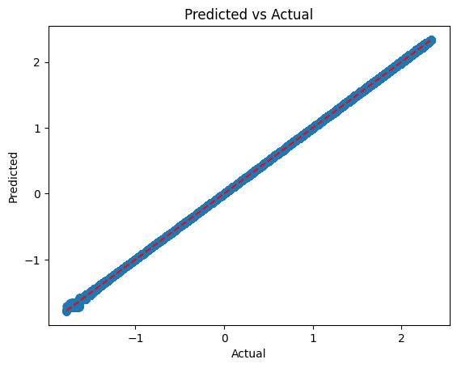
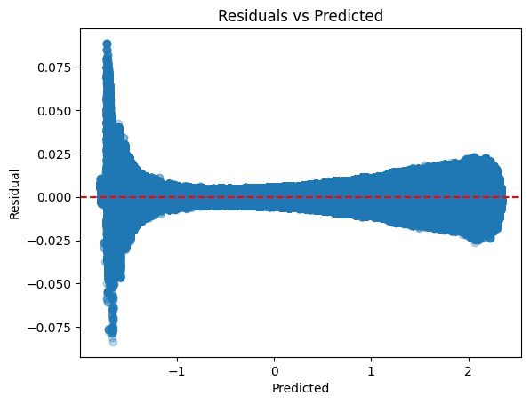
Pre-processing Issues
We were Forward filling realized volatility: ffill() replicates the current volatility into later rows within the same bucket. It creates perfectly predictable target rows, meaning optimistic RMSE.

Slide 3
Pre-processing Issues
Target transformation leakage: PowerTransformer was fitted on all data. Statistics from the validation set inform the transformation the model sees during training.
Feature leakage via IDs: stock_id, time_id, seconds_in_bucket fed to LightGBM as continuous variables. Tree splits can memorise IDs, again inflating test metrics.
PCA‑based stock selection: Picking the “top 30” most liquid stocks before modelling. This means the model will never learn cross‑sectional patterns in illiquid names, and back‑tests will over‑state live performance

Slide 4
Pre-processing Issues – Fixes
Removed ffill() completely as the model can train without needing redundant information.
Fixed the transformation leakage by fitting the transformer on y_train, then apply pt.transform() to both sets.
Dropped the stock_id and other features as we can’t One-Hot Encode.
For stock PCA: We will list it as limitation as we are limited with power.

Slide 5
Next Steps– Week 10
Add some more features such as realized quarticity to capture jump risk and encoded time to capture intraday seasonality.
Implement TimeSeriesSplit with a purge window of one complete time_id between folds, or use sliding window back‑tests (e.g. 60 % train / 20 % val / 20 % test rolling).
Keep working on the Ensemble and the presentation.

